Slide 1
www.CHEMSHEETS.co.uk
CELLS & BATTERIES
© www.chemsheets.co.uk GCSE 1161 20-Feb-17

Slide 2
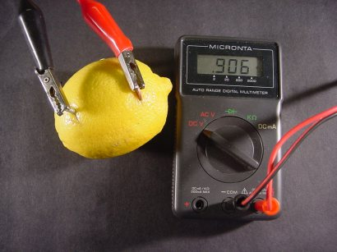
SIMPLE CELL
Two electrodes (two different metals) | e.g. Cu + Zn
Electrolyte (liquid that allows electricity to flow | e.g. juice in lemon, salt solution

Slide 3
Factors affecting the voltage:
Identity of metals (bigger the difference in reactivity → bigger voltage)
Electrolyte (identity and/or concentration)
© www.chemsheets.co.uk GCSE 1161 20-Feb-17

Slide 4
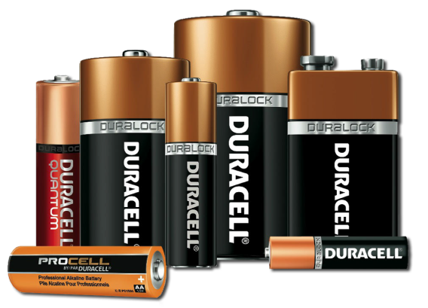
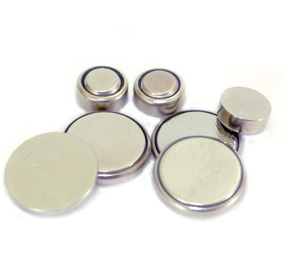
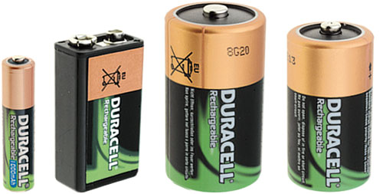

Slide 5
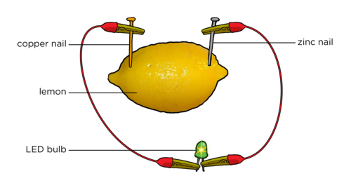
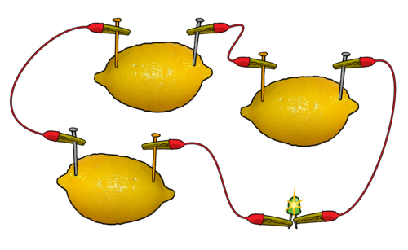
BATTERIES
one cell
battery = 2 or more cells connected

Slide 6
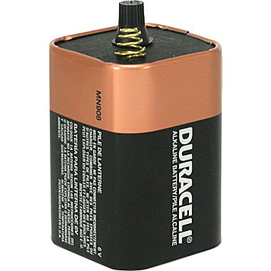
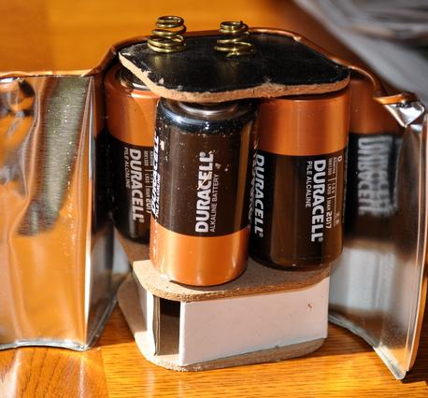
6V battery contains four 1.5V cells

Slide 7
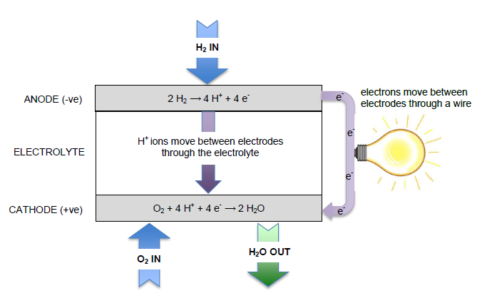
FUEL CELLS

Slide 8
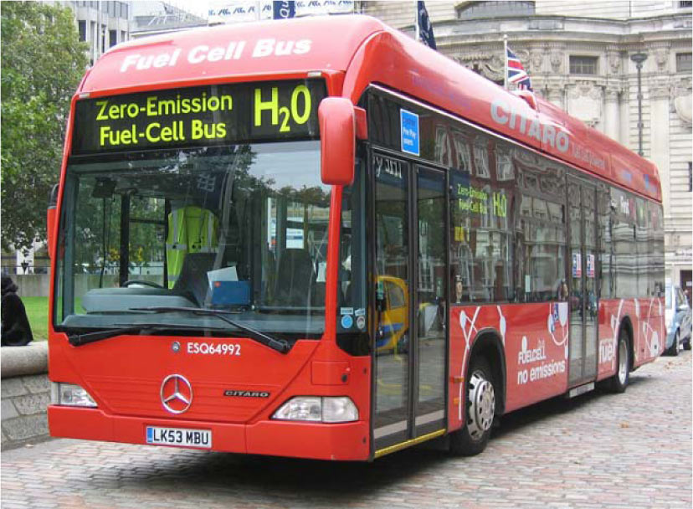

Slide 9
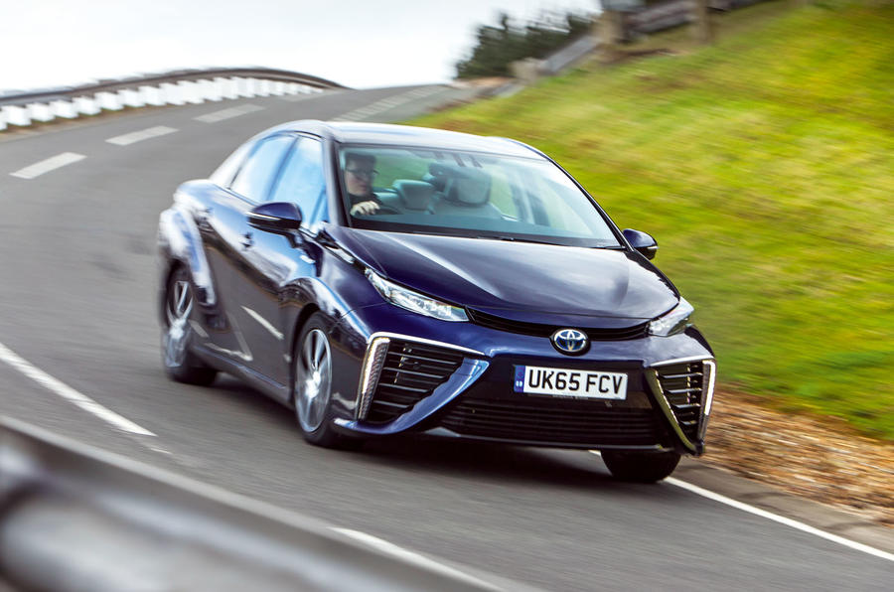
FUEL CELLS
Toyota Mirai

Slide 10
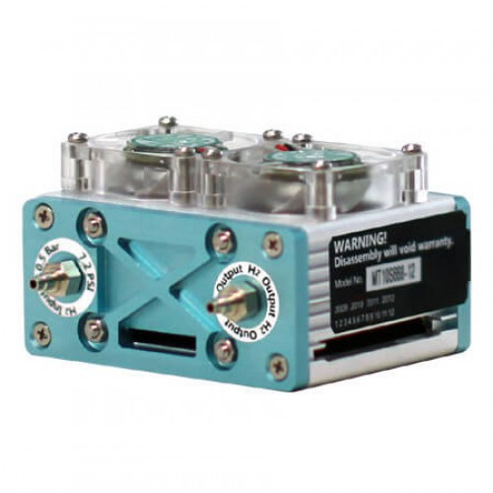
FUEL CELLS

Slide 11
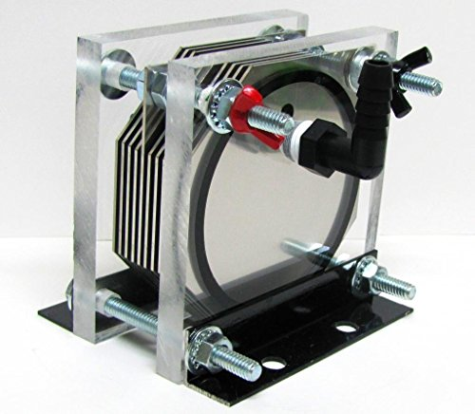
FUEL CELLS
Simple hydrogen fuel cell

Slide 12
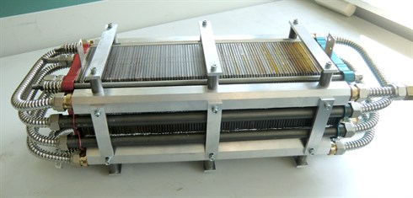
Hydrogen fuel cell stack

Slide 13
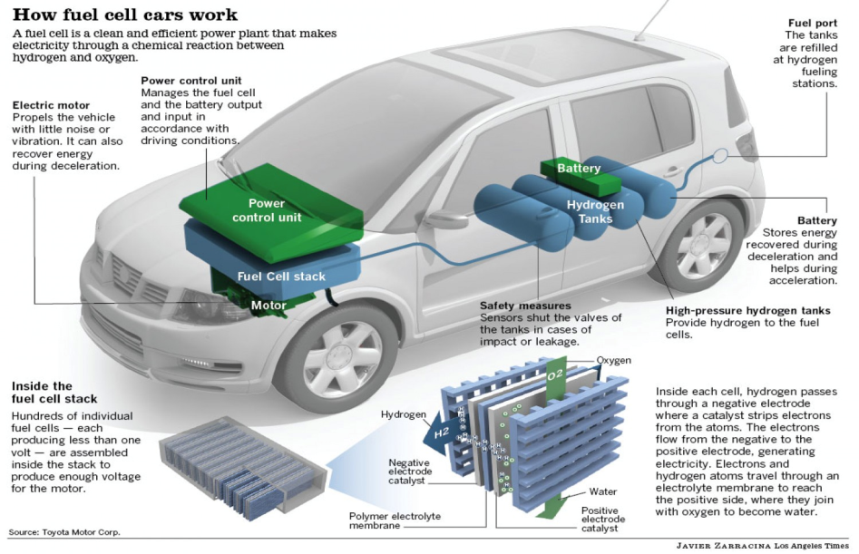
FUEL CELLS

Slide 14
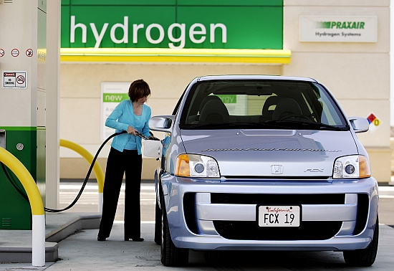

Slide 15
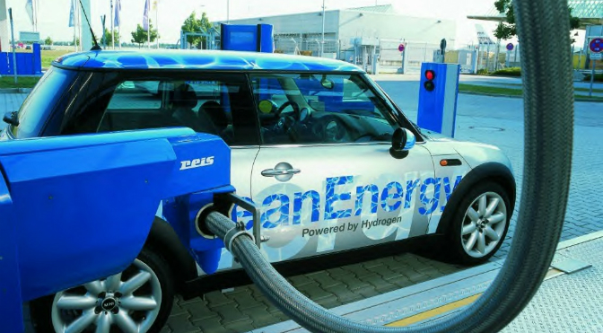

Slide 16
type of cell | non-rechargeable | rechargeable | fuel cells
note | goes flat (the voltage drops to zero) when the reactions inside stop (because one of the reactants has been used up) | can be recharged (because the chemical reactions can be reversed when connected to an external electric current) | have a continuous fuel supply so do not go flat or need recharging
examples | alkaline cells | lithium-ion cells (in mobile phones) | hydrogen fuel cell
pros | cheap | can be used many times cheaper than fuel cells | only waste product is water continuous supply of electricity (as long as there is a continuous supply of fuel)
cons | lots of used cells to dispose of (which contain toxic chemicals) | takes time to recharge more expensive than non-rechargeable cells | very expensive often use hydrogen which is flammable fossil fuels may be used to make hydrogen

