Slide 1
www.CHEMSHEETS.co.uk
ELECTROCHEMISTRY
© www.chemsheets.co.uk A2 1077 21-June-2023

Slide 2
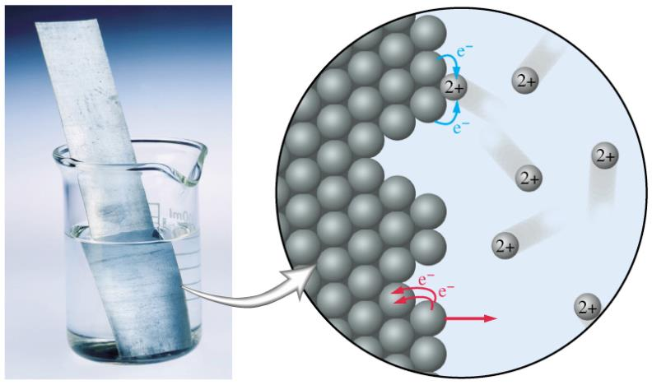
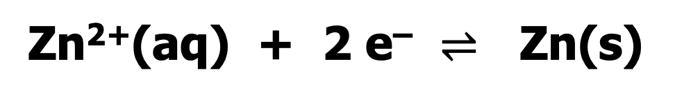
Zn²⁺(aq) + 2 e– $⇌$ Zn(s)

Slide 3
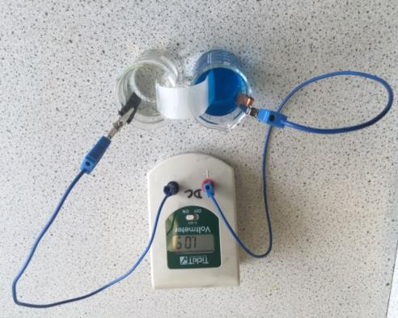
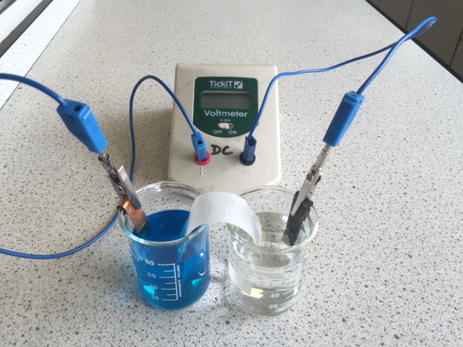
One of the two half cells [a piece of zinc in a solution of zinc nitrate(aq)]
Salt bridge [strip of filter paper soaked in saturated KNO₃(aq)]

Slide 4
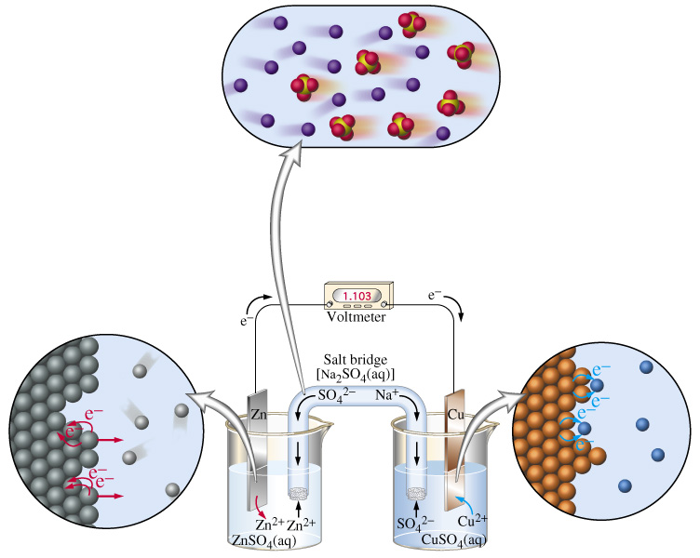

Slide 5
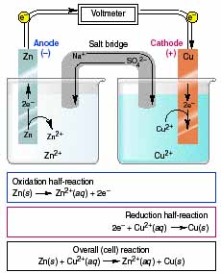

Slide 6
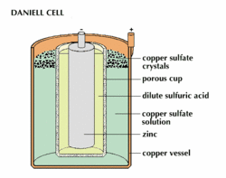
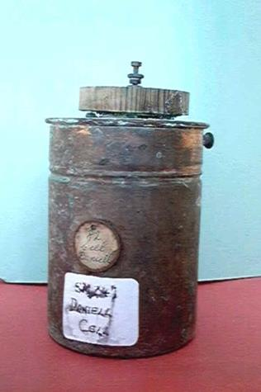

Slide 7
Standard Conditions
Concentration
1.0 mol dm⁻³ (ions involved in ½ equation)
Temperature
298 K
Pressure
100 kPa (if gases involved in ½ equation)
Current
Zero (use high resistance voltmeter)
© www.chemsheets.co.uk A2 1077 21-June-2023

Slide 8
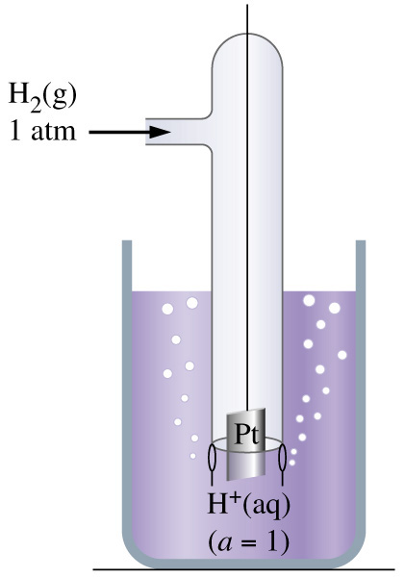
S tandard
H ydrogen
E lectrode

Slide 9
Pt(s) | H₂(g) | H⁺(aq) || Cu²⁺(aq) | Cu(s)
R O O R

Slide 10


R O O R
Pt(s) | H₂(g) | H⁺(aq) || Cu²⁺(aq) | Cu(s)

Slide 11
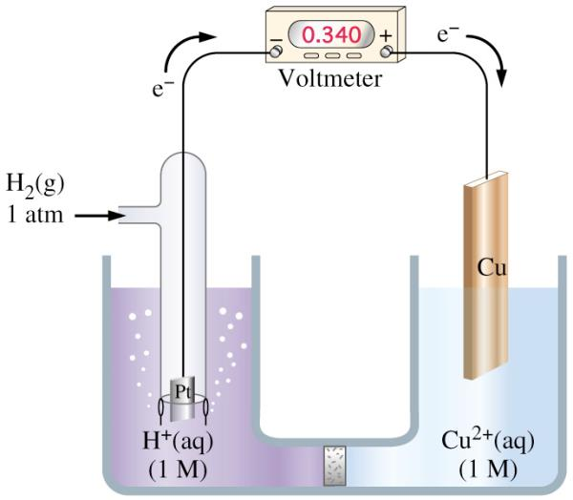
Pt(s) | H₂(g) | H⁺(aq) || Cu²⁺(aq) | Cu(s)
R O O R

Slide 12
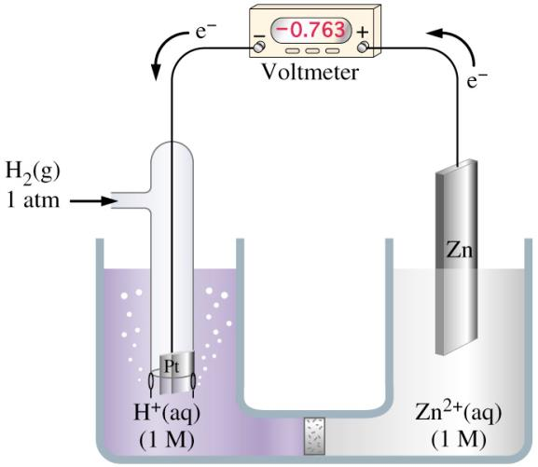
Pt(s) | H₂(g) | H⁺(aq) || Zn²⁺(aq) | Zn(s)
R O O R

Slide 13
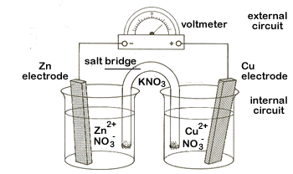
Zn(s) | Zn²⁺(aq) || Cu²⁺(aq) | Cu(s)
R O O R

Slide 14
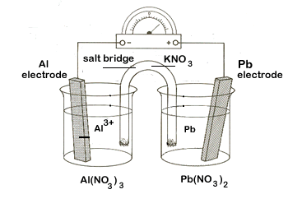
Al(s) | Al³⁺(aq) || Pb²⁺(aq) | Pb(s)
R O O R

Slide 15
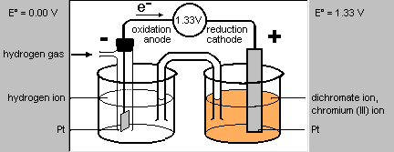
Pt(s) | H₂(g) | H⁺(aq) || Cr₂O₇^{2–}(aq), H⁺(aq), Cr³⁺(aq) | Pt(s)
R O O R

Slide 16
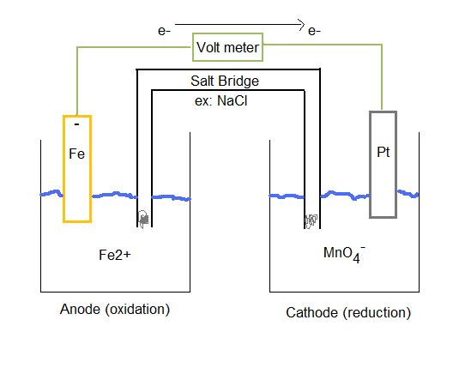
Fe(s) | Fe²⁺(aq) || MnO₄–(aq), H⁺(aq), Mn²⁺(aq) | Pt(s)
R O O R

Slide 17
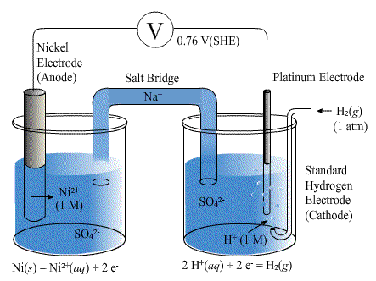
Ni(s) | Ni²⁺(aq) || H⁺(aq) | H₂(g) | Pt(s)
R O O R

Slide 18
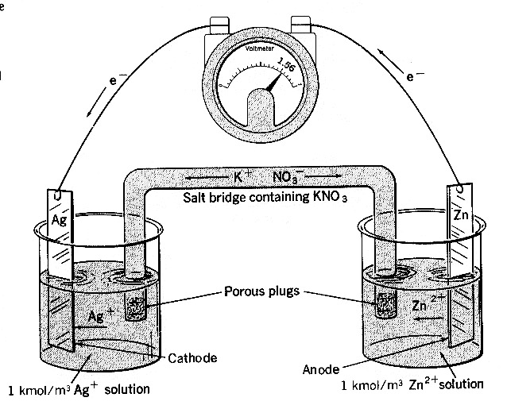
Ag(s) | Ag⁺(aq) || Zn²⁺(aq) | Zn(s)
R O O R

Slide 19
emf = E°_{right} - E°_{left}
emf = E°_{right}

Slide 20
- electrode
anode
oxidation
+ electrode
cathode
reduction
electron flow
At this electrode the metal loses electrons and so is oxidised to metal ions.
These electrons make the electrode negative.
At this electrode the metal ions gain electrons and so is reduced to metal atoms.
As electrons are used up, this makes the electrode positive.
Zn
Cu
Zn → Zn²⁺ + 2 e⁻
oxidation
Cu²⁺ + 2 e⁻ → Cu
reduction
© www.chemsheets.co.uk A2 1077 21-June-2023

Slide 21
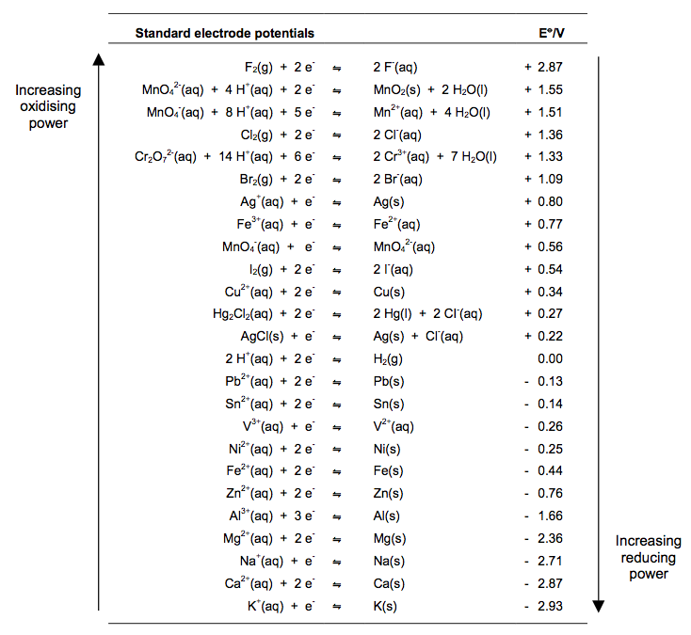
The electrochemical series
best oxidising agents
best reducing agents

Slide 22

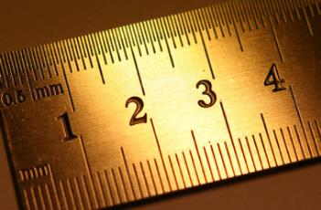
The more +ve electrode gains electrons
(+ charge attracts electrons)

Slide 23


–
0
+
–ve electrode
+ve electrode
e–
+ 1.10 V
+ 0.34 V
Cu²⁺ + 2 e⁻ $⇌$ Cu
– 0.76 V
Zn²⁺ + 2 e⁻ $⇌$ Zn
Cu²⁺ + Zn → Cu + Zn²⁺
© www.chemsheets.co.uk A2 1077 21-June-2023

Slide 24


TASK 9 – Q1
–
0
+
–ve electrode
+ve electrode
e–
+ 0.51 V
– 0.25 V
Ni²⁺ + 2 e⁻ $⇌$ Ni
– 0.76 V
Zn²⁺ + 2 e⁻ $⇌$ Zn
Ni²⁺ + Zn → Ni + Zn²⁺
E°(Ni²⁺/Ni) > E°(Zn²⁺/Zn) and therefore Ni²⁺ gains electrons from Zn

Slide 25


TASK 9 – Q2
0
+
–ve electrode
+ve electrode
e–
+ 0.46 V
+ 0.80 V
Ag⁺ + e⁻ $⇌$ Ag
+ 0.34 V
Cu²⁺ + 2 e⁻ $⇌$ Cu
2 Ag⁺ + Cu → 2 Ag + Cu²⁺
E°(Ag⁺/Ag) > E°(Cu²⁺/Cu) and therefore Ag⁺ gains electrons from Cu

Slide 26

TASK 9 – Q3
0
+
+ 1.36 V
Cl₂ + 2 e⁻  2 Cl⁻
+ 0.77 V
+ 1.51 V
Fe³⁺ + e⁻ $⇌$ Fe²⁺
MnO₄⁻ + 8 H⁺ + 5 e⁻ $⇌$ Mn²⁺ + 4 H₂O
NO
+ 1.33 V
YES
Cr₂O₇²⁻ + 14 H⁺ + 6 e⁻ $⇌$ 2 Cr³⁺ + 7 H₂O
NO
MnO₄– will oxidise Cl– to form Cl₂ as E°(MnO₄–/Mn²⁺) > E°(Cl₂/ Cl–) and therefore MnO₄– gains electrons from Cl–

Slide 27


TASK 9 – Q4a
Pt(s)|H₂(g)|H⁺(aq)||Br₂(aq),Br⁻(aq)|Pt(s)
0
+
–ve electrode
)anode
+ve electrode
e–
+ 1.09 V
+ 1.09 V
Br₂ + 2 e⁻ $⇌$ 2 Br⁻
0.00 V
H₂ + Br₂ → 2 H⁺ + 2 Br⁻
2 H⁺ + 2 e⁻ $⇌$ H₂
E°(Br₂/Br–) > E°(H⁺/H₂) and therefore Br₂ gains electrons from H₂

Slide 28


TASK 9 – Q4b
Cu(s)|Cu²⁺(aq)||Fe³⁺(aq),Fe²⁺(aq)|Pt(s)
0
+
–ve electrode
+ve electrode
e–
+ 0.43 V
+ 0.77 V
Fe³⁺ + e⁻ $⇌$ Fe²⁺
+ 0.34 V
2 Fe³⁺ + Cu → 2 Fe²⁺ + Cu²⁺
Cu²⁺ + 2 e⁻ $⇌$ Cu
E°(Fe³⁺/Fe²⁺) > E°(Cu²⁺/Cu) and therefore Fe³⁺ gains electrons from Cu

Slide 29


TASK 9 – Q6a
Fe(s)|Fe²⁺(aq)||H⁺(aq)|H₂(g)|Pt(s)
–
0
–ve electrode
+ve electrode
e–
+ 0.44 V
0.00 V
2 H⁺ + 2 e⁻ $⇌$ H₂
– 0.44 V
YES: H⁺ oxidises Fe to Fe²⁺
Fe²⁺ + 2 e⁻ $⇌$ Fe
E°(H⁺/H₂) > E°(Fe²⁺/Fe) and therefore H⁺ gains electrons from Fe

Slide 30


TASK 9 – Q6b
0
+
–ve electrode
+ve electrode
e–
+ 0.34 V
+ 0.34 V
Cu²⁺ + 2 e⁻ $⇌$ Cu
0.00 V
NO: H⁺ won’t oxidise Cu to Cu²⁺
2 H⁺ + 2 e⁻ $⇌$ H₂
E°(H⁺/H₂) < E°(Cu²⁺/Cu) and therefore H⁺ cannot gain electrons from Cu

Slide 31

TASK 9 – Q6c
0
+
–ve electrode
+ve electrode
e–
+ 0.03 V
+ 1.36 V
+ 1.33 V
Cl₂ + 2 e⁻ $⇌$ 2 Cl⁻
Cr₂O₇²⁻ + 14 H⁺ + 6 e⁻ $⇌$ 2 Cr³⁺ + 7 H₂O
NO: H⁺/Cr₂O₇²⁻ won’t oxidise Cl⁻ to Cl₂
E°(Cr₂O₇^{2–}/Cr³⁺) < E°( Cl₂/ Cl–) and therefore Cr₂O₇^{2–} cannot gain electrons from Cl–

Slide 32

TASK 9 – Q6d
Pt(s)|Cl⁻(aq)|Cl₂(g)||MnO₄⁻ (aq),H⁺(aq),Mn²⁺(aq)|Pt(s)
0
+
–ve electrode
+ve electrode
e–
+ 0.03 V
+ 1.51 V
+ 1.36 V
MnO₄⁻ + 8 H⁺ + 5 e⁻ $⇌$ Mn²⁺ + 4 H₂O
Cl₂ + 2 e⁻ $⇌$ 2 Cl⁻
YES: H⁺/MnO₄⁻ oxidises Cl⁻ to Cl₂
E°(MnO₄–/Mn²⁺) > E°(Cl₂/ Cl–) and therefore MnO₄– gains electrons from Cl–

Slide 33


TASK 9 – Q6e
Mg(s)|Mg²⁺(aq)||V³⁺(aq),V²⁺(aq)|Pt(s)
–
0
–ve electrode
+ve electrode
e–
+ 2.10 V
– 0.26 V
V³⁺ + e⁻ $⇌$ V²⁺
– 2.36 V
YES: Mg reduces V³⁺ to V²⁺
Mg²⁺ + 2 e⁻ $⇌$ Mg
E°(V³⁺/V²⁺) > E°(Mg²⁺/Mg) and therefore V³⁺ gains electrons from Mg

Slide 34
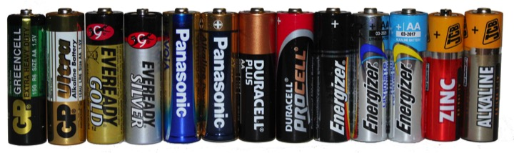
Commercial Cells Non rechargeable

Slide 35
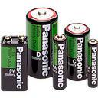
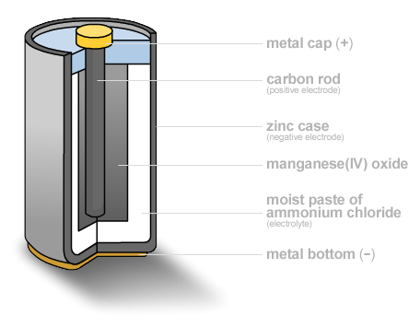

Non-rechargeable cells – Zinc-carbon
Standard cell
Short life
–0.80 V Zn(NH₃)₂²⁺ + 2 e⁻ Zn + 2 NH₃
+0.70 V 2 MnO₂ + 2 H⁺ + 2 e– Mn₂O₃ + H₂O
2 MnO₂ + 2 H⁺ + Zn + 2 NH₃ → Mn₂O₃ + H₂O + Zn(NH₃)₂²⁺
Emf = +1.50 V

Slide 36
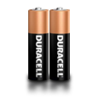
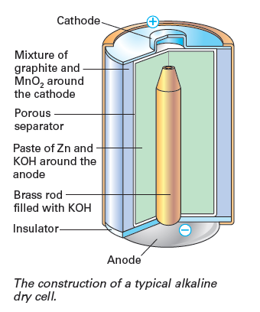
Non-rechargeable cells – alkaline
Longer life
–0.76 V Zn²⁺ + 2 e– Zn
+0.84 V MnO₂ + H₂O + e– MnO(OH) + OH–
2MnO₂ + 2H₂O + Zn → 2MnO(OH) + 2OH– + Zn²⁺
Emf = +1.60 V

Slide 37

Commercial Cells Rechargeable

Slide 38
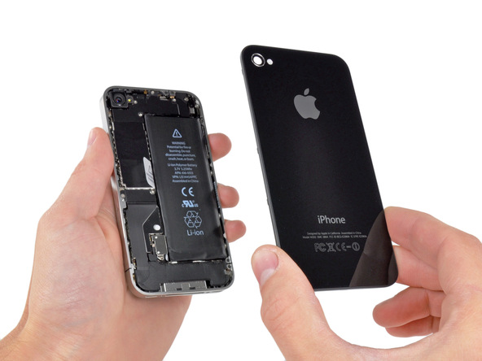
Rechargeable cells – Li ion
Rechargeable
Most common rechargeable cell
+0.60 V Li⁺ + CoO₂ + e– LiCoO₂
–3.00 V Li⁺ + e– Li
In use: CoO₂ + Li → LiCoO₂
Charging: LiCoO₂ → CoO₂ + Li Emf = +3.60 V

Slide 39
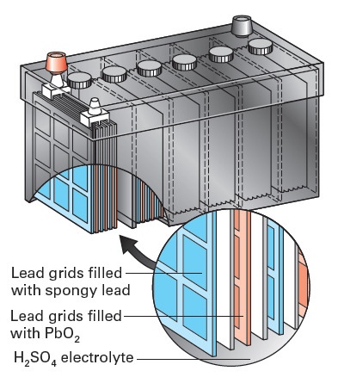
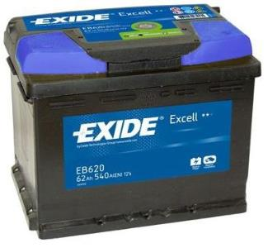
Used in sealed car batteries (6 cells giving about 12 V overall)
Rechargeable cells – lead-acid
+1.68 V PbO₂ + 3H⁺ + HSO₄– + 2e– PbSO₄ + 2H₂O
–0.36 V PbSO₄ + H⁺ + 2e– Pb + HSO₄–
In use: PbO₂ + Pb + 2H⁺ + 2HSO₄– → 2PbSO₄ + 2H₂O
Charging: 2PbSO₄ + 2H₂O → PbO₂ + Pb + 2H⁺ + 2HSO₄– Emf = +2.04 V

Slide 40
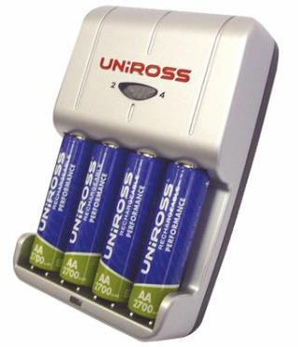
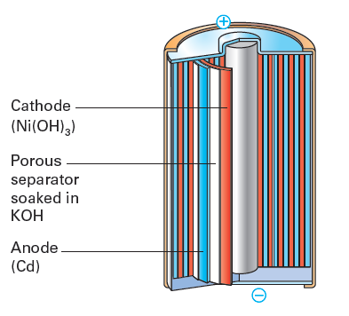
Rechargeable cells – nickel-cadmium
+0.52 V NiO(OH) + H₂O + e– Ni(OH)₂ + OH–
–0.88 V Cd(OH)₂ + 2 e– Cd + 2 OH–
In use: 2NiO(OH) + 2H₂O + Cd → 2Ni(OH)₂ + Cd(OH)₂
Charging: 2Ni(OH)₂ + Cd(OH)₂ → 2NiO(OH) + 2H₂O + Cd Emf = +1.40 V

Slide 41
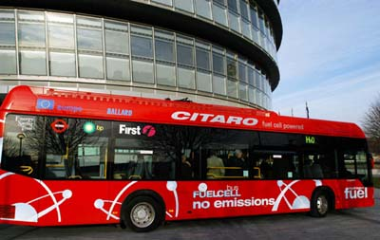
Commercial Cells Fuel Cells

Slide 42
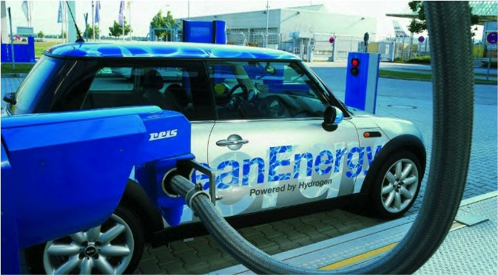

Slide 43
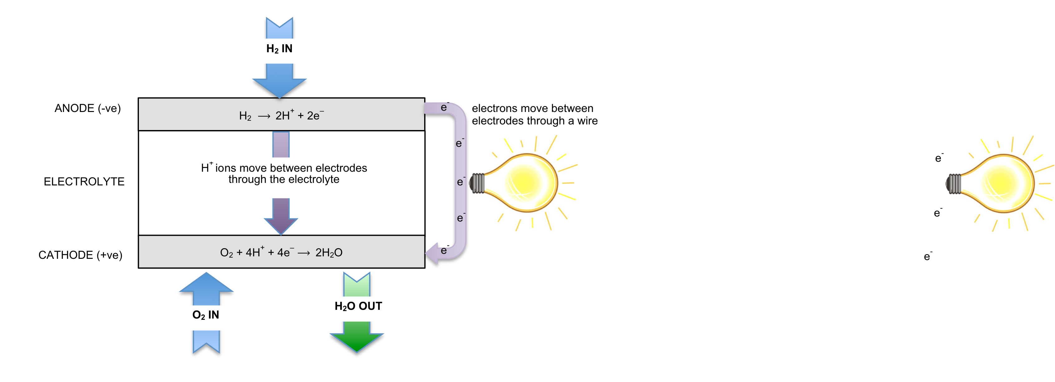
Hydrogen-Oxygen FUEL CELLS
(acidic conditions)

Slide 44
Hydrogen-Oxygen FUEL CELLS
(alkaline conditions)
2H₂ + 4OH– ⟶ 4H₂O + 4e–
OH– ions move between electrodes through electrolyte
O₂ + 2H₂O + 4e– ⟶ 4OH–

Slide 45
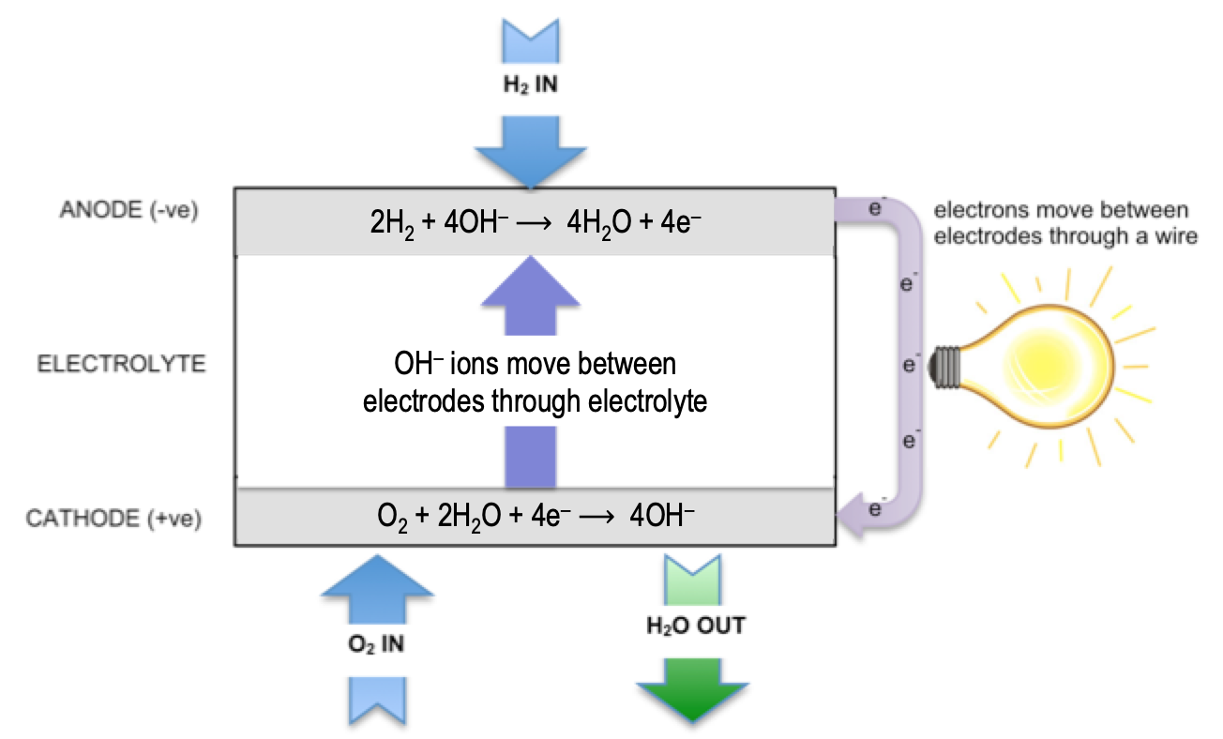
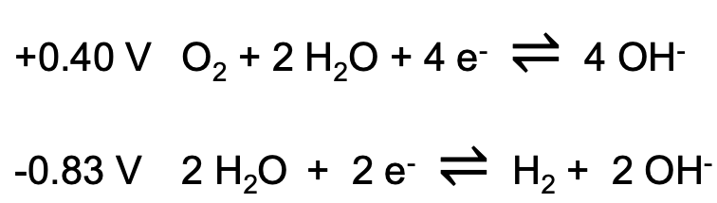
Hydrogen-Oxygen FUEL CELLS
High efficiency (more efficient than burning hydrogen)
How is H₂ made?
Input of H₂/O₂ to replenish so no need to recharge
+0.40 V O₂ + 2 H₂O + 4 e⁻ $⇌$ 4 OH⁻
-0.83 V 2 H₂O + 2 e⁻ $⇌$ H₂ + 2 OH⁻
Determine: a) cell emf b) overall reaction

Slide 46
 | hydrogen fuel cell (alkaline) | hydrogen fuel cell (acidic)
Negative electrode (anode) | H₂ + 2OH– ⟶ 2H₂O + 2e– E° = –0.83 V | H₂ ⟶ 2H⁺ + 2e– E° = +0.00 V
Positive electrode (cathode) | O₂ + 2H₂O + 4e– ⟶ 4OH– E° = +0.40 V | O₂ + 4H⁺ + 4e– ⟶ 2H₂O E° = +1.23 V
Overall equation | 2H₂ + O₂ ⟶ 2H₂O | 2H₂ + O₂ ⟶ 2H₂O
Cell emf | +1.23 V | +1.23 V
© www.chemsheets.co.uk A2 1077 21-June-2023

Slide 47
Benefits & risks of using cells
 | Benefits | Risks
Using cells | portable source of electrical energy | waste issues
Using non-rechargeable cells | cheap | waste issues
Using re-chargeable cells | less waste cheaper in the long run lower environmental impact | some waste issues (at end of useful life)
Using hydrogen fuel cells | only waste product is water do not need re-charging very efficient | need constant supply of fuels hydrogen is flammable & explosive hydrogen usually made using fossil fuels high cost of fuel cells
© www.chemsheets.co.uk A2 1077 2-July-2016

